Slide 1
CSE 319 Software Engineering
Lecture : Performing user interface design
Anisur Rahman
Military Institute of Science and Technology

Slide 2
What is User Interface?
User interface is the front-end application view to which user interacts in order to use the software. The software becomes more popular if its user interface is:
Attractive
Simple to use
Responsive in short time
Clear to understand
Consistent on all interface screens
Notes:
User interface is the front-end application view to which user interacts in order to use the software. User can manipulate and control the software as well as hardware by means of user interface. Today, user interface is found at almost every place where digital technology exists, right from computers, mobile phones, cars, music players, airplanes, ships etc.
User interface is part of software and is designed such a way that it is expected to provide the user insight of the software. UI provides fundamental platform for human-computer interaction.
UI can be graphical, text-based, audio-video based, depending upon the underlying hardware and software combination. UI can be hardware or software or a combination of both.

Slide 3
Types of Interface
There are two types of User Interface:
Command Line Interface: Command Line Interface provides a command prompt, where the user types the command and feeds to the system. The user needs to remember the syntax of the command and its use.
Graphical User Interface: Graphical User Interface provides the simple interactive interface to interact with the system. GUI can be a combination of both hardware and software. Using GUI, user interprets the software.

Slide 4
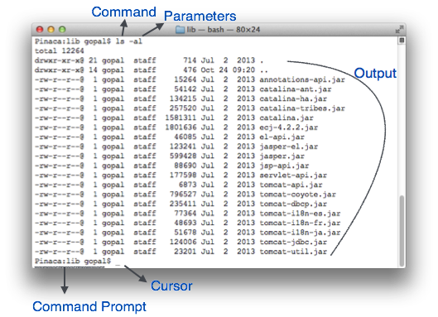
Command Line Interface (CLI)
Notes:
CLI has been a great tool of interaction with computers until the video display monitors came into existence. CLI is first choice of many technical users and programmers. CLI is minimum interface a software can provide to its users.
CLI provides a command prompt, the place where the user types the command and feeds to the system. The user needs to remember the syntax of command and its use. Earlier CLI were not programmed to handle the user errors effectively.
A command is a text-based reference to set of instructions, which are expected to be executed by the system. There are methods like macros, scripts that make it easy for the user to operate.
CLI uses less amount of computer resource as compared to GUI.

Slide 5
CLI Elements
A text-based command line interface can have the following elements:
Command Prompt - It is text-based notifier that is mostly shows the context in which the user is working. It is generated by the software system.
Cursor - It is a small horizontal line or a vertical bar of the height of line, to represent position of character while typing. Cursor is mostly found in blinking state. It moves as the user writes or deletes something.
Command - A command is an executable instruction. It may have one or more parameters. Output on command execution is shown inline on the screen. When output is produced, command prompt is displayed on the next line.

Slide 6
Graphical User Interface
Graphical User Interface provides the user graphical means to interact with the system. GUI can be combination of both hardware and software. Using GUI, user interprets the software.
Typically, GUI is more resource consuming than that of CLI. With advancing technology, the programmers and designers create complex GUI designs that work with more efficiency, accuracy and speed.

Slide 7
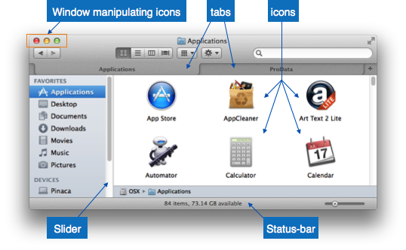
GUI Elements
Window
Tabs
Interface
Menu
Icon
Cursor
Notes:
Window - An area where contents of application are displayed. Contents in a window can be displayed in the form of icons or lists, if the window represents file structure. It is easier for a user to navigate in the file system in an exploring window. Windows can be minimized, resized or maximized to the size of screen. They can be moved anywhere on the screen. A window may contain another window of the same application, called child window.
Tabs - If an application allows executing multiple instances of itself, they appear on the screen as separate windows. Tabbed Document Interface has come up to open multiple documents in the same window. This interface also helps in viewing preference panel in application. All modern web-browsers use this feature.
Menu - Menu is an array of standard commands, grouped together and placed at a visible place (usually top) inside the application window. The menu can be programmed to appear or hide on mouse clicks.
Icon - An icon is small picture representing an associated application. When these icons are clicked or double clicked, the application window is opened. Icon displays application and programs installed on a system in the form of small pictures.
Cursor - Interacting devices such as mouse, touch pad, digital pen are represented in GUI as cursors. On screen cursor follows the instructions from hardware in almost real-time. Cursors are also named pointers in GUI systems. They are used to select menus, windows and other application features.

Slide 8
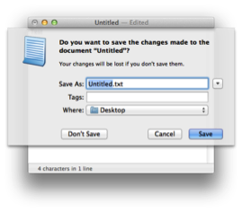
Application specific GUI components (1)
A GUI of an application contains one or more of the listed GUI elements:
Application Window - Most application windows uses the constructs supplied by operating systems but many use their own customer created windows to contain the contents of application.

Slide 9
Application specific GUI components (2)
Dialogue Box - It is a child window that contains message for the user and request for some action to be taken. For Example: Application generate a dialogue to get confirmation from user to delete a file.

Slide 10
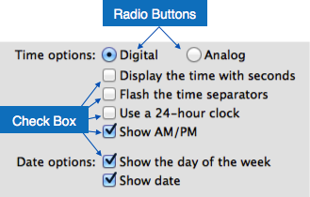
Application specific GUI components (3)
Text-Box - Provides an area for user to type and enter text-based data.
Buttons - They imitate real life buttons and are used to submit inputs to the software.
Radio-button - Displays available options for selection. Only one can be selected among all offered.

Slide 11
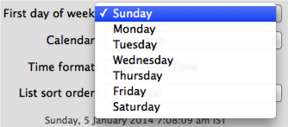
Application specific GUI components (4)
Check-box - Functions similar to list-box. When an option is selected, the box is marked as checked. Multiple options represented by check boxes can be selected.
List-box - Provides list of available items for selection. More than one item can be selected.

Slide 12
Application specific GUI components (5)
Other impressive GUI components are:
Sliders
Combo-box
Data-grid
Drop-down list

Slide 13
User Interface Design Activities
There are a number of activities performed for designing user interface.
The process of GUI design and implementation is alike SDLC.
Any model can be used for GUI implementation among Waterfall, Iterative or Spiral Model.

Slide 14
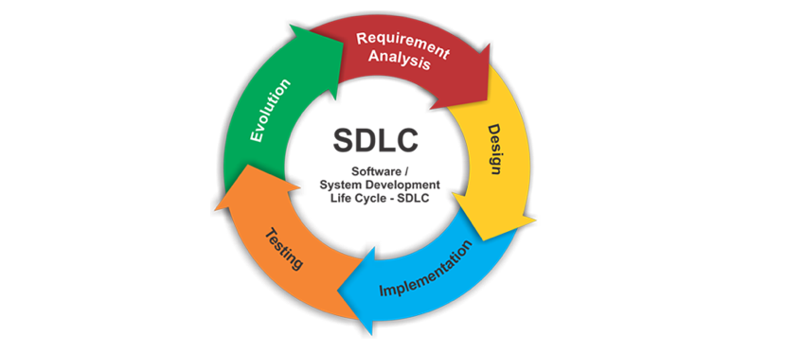
Software Development Life Cycle

Slide 15
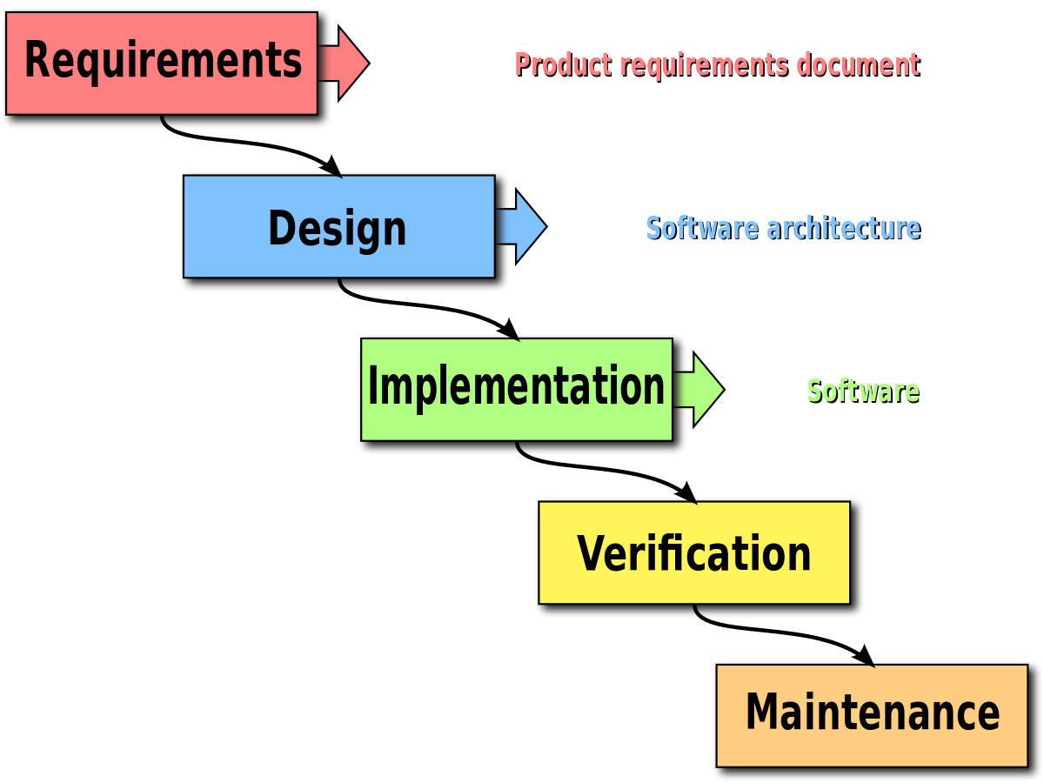
Waterfall Model

Slide 16
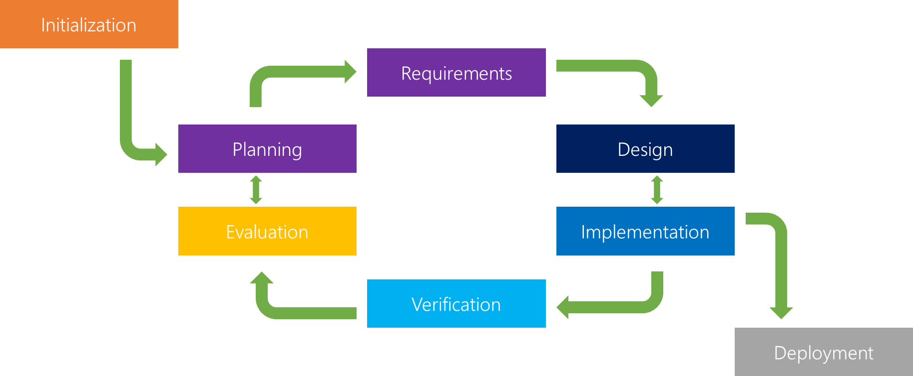
Iterative Life cycle model

Slide 17
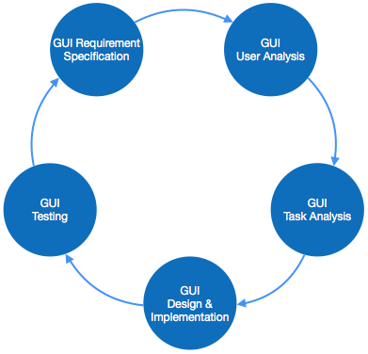
GUI Model (1)
A model used for GUI design and development should fulfill these GUI specific steps.

Slide 18
GUI Model (2)
GUI Requirement Gathering - The designers may like to have list of all functional and non-functional requirements of GUI. This can be taken from user and their existing software solution.
User Analysis - The designer studies who is going to use the software GUI. The target audience matters as the design details change according to the knowledge and competency level of the user. If user is technical savvy, advanced and complex GUI can be incorporated. For a novice user, more information is included on how-to of software.

Slide 19
GUI Model (3)
Task Analysis - Designers have to analyze what task is to be done by the software solution. Here in GUI, it does not matter how it will be done. Tasks can be represented in hierarchical manner taking one major task and dividing it further into smaller sub-tasks. Tasks provide goals for GUI presentation. Flow of information among sub-tasks determines the flow of GUI contents in the software.
GUI Design & implementation - Designers after having information about requirements, tasks and user environment, design the GUI and implements into code and embed the GUI with working or dummy software in the background. It is then self-tested by the developers.

Slide 20
GUI Model (4)
Testing - GUI testing can be done in various ways. Organization can have in-house inspection, direct involvement of users and release of beta version are few of them. Testing may include usability, compatibility, user acceptance etc.

Slide 21
GUI Implementation Tools
There are several tools available using which the designers can create entire GUI on a mouse click. Some tools can be embedded into the software environment (IDE).
GUI implementation tools provide powerful array of GUI controls. For software customization, designers can change the code accordingly.
There are different segments of GUI tools according to their different use and platform.

Slide 22
GUI Implementation Tools - Example
Mobile GUI, Computer GUI, Touch-Screen GUI etc. Here is a list of few tools which come handy to build GUI:
FLUID
AppInventor (Android)
LucidChart
Wavemaker
Visual Studio

Slide 23
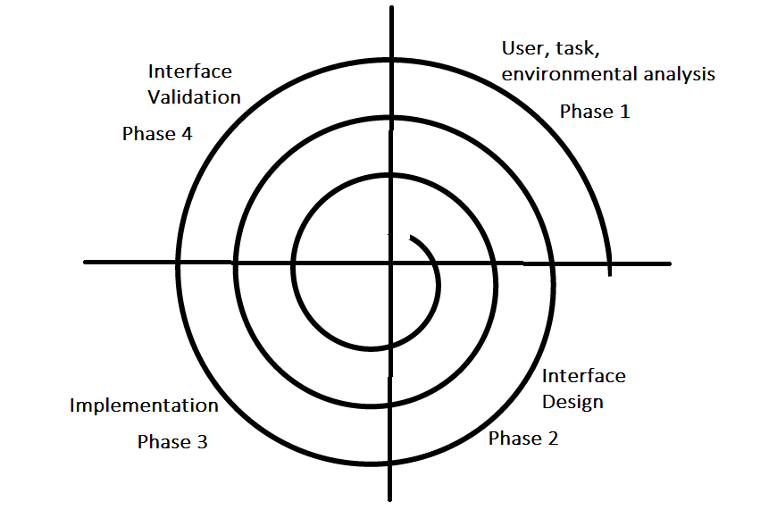
User Interface Design Process (1)

Slide 24
User Interface Design Process (2)
User, task, environmental analysis, and modeling: Initially, the focus is based on the profile of users who will interact with the system, i.e. understanding, skill and knowledge, type of user, environment, etc, based on the user’s profile users are made into categories.

Slide 25
User Interface Design Process (3)
The analysis of the user environment focuses on the physical work environment. Among the questions to be asked are:
Where will the interface be located physically?
Will the user be sitting, standing, or performing other tasks unrelated to the interface?
Does the interface hardware accommodate space, light, or noise constraints?
Are there special human factors considerations driven by environmental factors?

Slide 26
User Interface Design Process (4)
Interface Design: The goal of this phase is to define the set of interface objects and actions i.e. Control mechanisms that enable the user to perform desired tasks. Indicate how these control mechanisms affect the system. Specify the action sequence of tasks and subtasks, also called a user scenario. Indicate the state of the system when the user performs a particular task.
Always follow the three golden rules stated by Theo Mandel. Place Users in Control, Reduce User's Memory Load, Make the Interface Consistent
Design issues such as response time, command and action structure, error handling, and help facilities are considered as the design model is refined. This phase serves as the foundation for the implementation phase.

Slide 27
User Interface Design Process (5)
Interface construction and implementation: The implementation activity begins with the creation of prototype (model) that enables usage scenarios to be evaluated. As iterative design process continues a User Interface toolkit that allows the creation of windows, menus, device interaction, error messages, commands, and many other elements of an interactive environment can be used for completing the construction of an interface.

Slide 28
User Interface Design Process (6)
Interface Validation: This phase focuses on testing the interface. The interface should be in such a way that it should be able to perform tasks correctly and it should be able to handle a variety of tasks. It should achieve all the user’s requirements. It should be easy to use and easy to learn. Users should accept the interface as a useful one in their work.

Slide 29
“
What happens if we have to explain it ?
Or
The result of a poor UI ?

Slide 30


Google Wave that failed due to its poor UI design.

Slide 31
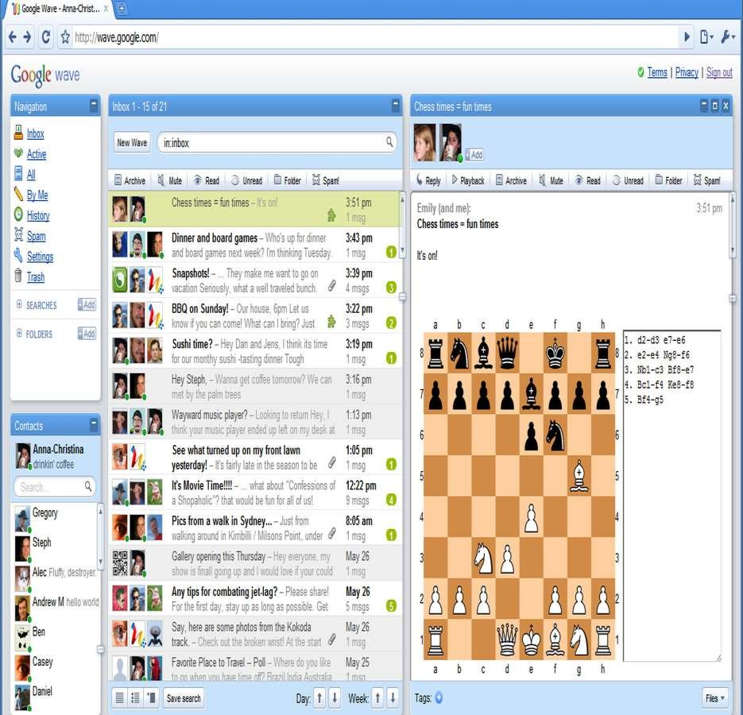

Slide 32
Golden Rules (1)
Place the user in control: Define the interaction modes in such a way that does not force the user into unnecessary or undesired actions: The user should be able to easily enter and exit the mode with little or no effort.
Provide for flexible interaction
Allow user interaction to be interruptible and undoable
Hide technical internals from casual users
Design for direct interaction with objects that appear on screen
Notes:
Define the interaction modes in such a way that does not force the user into unnecessary or undesired actions: The user should be able to easily enter and exit the mode with little or no effort.
Provide for flexible interaction: Different people will use different interaction mechanisms, some might use keyboard commands, some might use mouse, some might use touch screen, etc, Hence all interaction mechanisms should be provided.
Allow user interaction to be interruptable and undoable: When a user is doing a sequence of actions the user must be able to interrupt the sequence to do some other work without losing the work that had been done. The user should also be able to do undo operation.
Streamline interaction as skill level advances and allow the interaction to be customized: Advanced or highly skilled user should be provided a chance to customize the interface as user wants which allows different interaction mechanisms so that user doesn’t feel bored while using the same interaction mechanism.
Hide technical internals from casual users: The user should not be aware of the internal technical details of the system. He should interact with the interface just to do his work.
Design for direct interaction with objects that appear on screen: The user should be able to use the objects and manipulate the objects that are present on the screen to perform a necessary task. By this, the user feels easy to control over the screen.

Slide 33



1. Place the user in control
"What I really would like,” said the user solemnly, is a system that reads my mind. It knows what I want to do before I need to do it and makes it very easy for me to get it done. That’s all, just that.”
-During a requirements-gathering session, a key user was asked about the attributes of the window-oriented graphical interface.

Slide 34
1. Place the user in control
Users want to control the computer but does not want to be controlled by the computer. So, user interface constraints specified by the designer must simplify the mode of user's interaction with the computer. User interface must not frustrate the user.

Slide 35
1. Place the user in control
1.
Define interaction modes in a way that does not force a user into unnecessary or undesired actions.

Slide 36

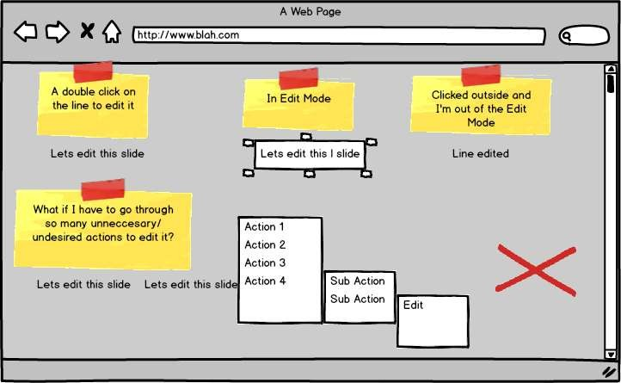

The user should always be able to enter and exit the mode with little or no effort.

Slide 37
1. Place the user in control
2.
Provide for flexible interaction

Slide 38
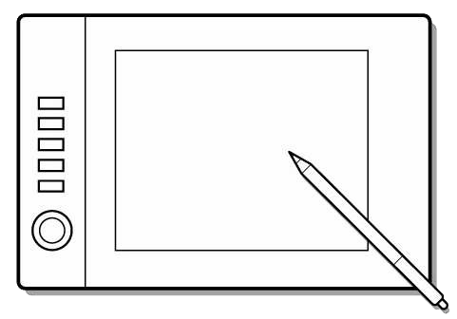


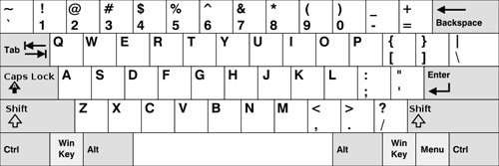

Different users have different interaction preferences, choices should be provided.
Drawing complex shapes via
keyboard commands frustrates users but doing the same via mouse is simple.

Slide 39
1. Place the user in control
3.
Allow user interaction to be interruptible and undoable.

Slide 40
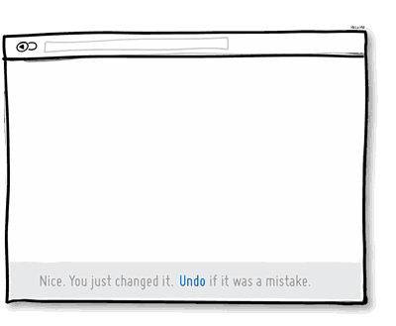
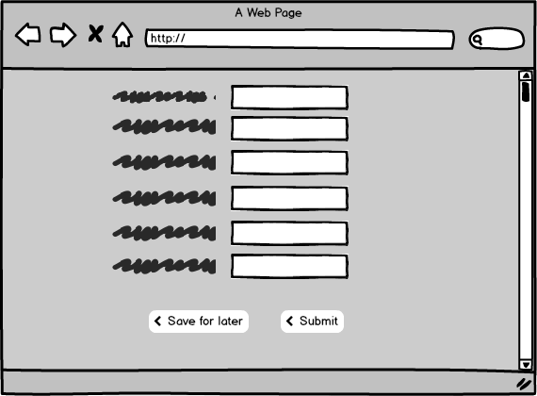

User should be able to interrupt even when in a sequence of actions but without losing any progress. Also, any user action must be undoable.

Slide 41
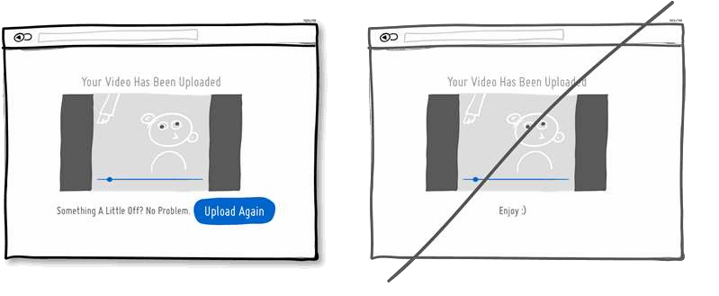
User should be able to interrupt even when in a sequence of actions but without losing any progress. Also, any user action must be undoable.

Slide 42
1. Place the user in control
4.
Streamline interaction as skill levels advance and allow the interaction to be customized.

Slide 43

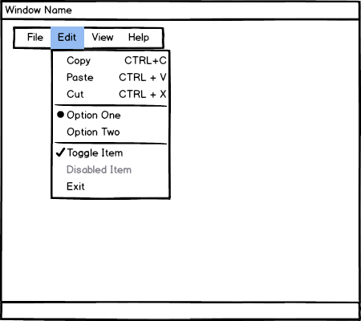

Users may be normal people or computer experts. Users of different skill levels should be able to interact with a program at different levels.

Slide 44
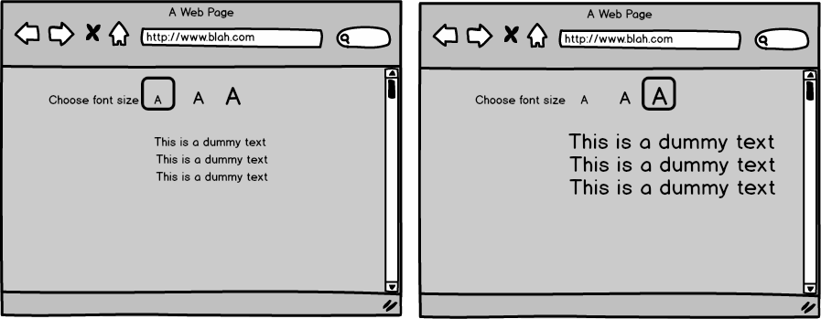
Users may be normal people or computer experts. Users of different skill levels should be able to interact with a program at different levels.

Slide 45
1. Place the user in control
5.
Hide technical internals from the casual user.

Slide 46
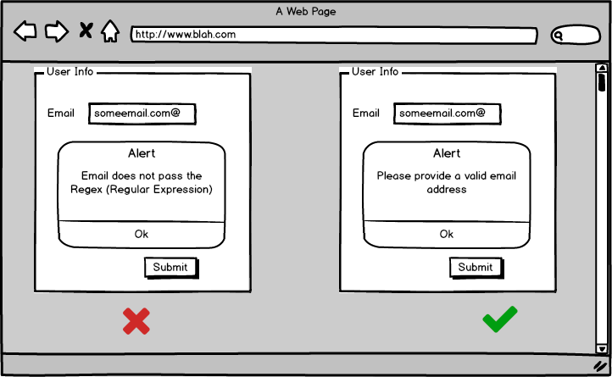

The user should not be aware of the operating system, file management functions, or other arcane computing technology.

Slide 47
1. Place the user in control
6.
Design for direct interaction with objects that appear on the screen.

Slide 48

The user feels a sense of control when able to manipulate the objects that are necessary to perform a task in a manner similar to what would occur if the object were a physical thing

Slide 49
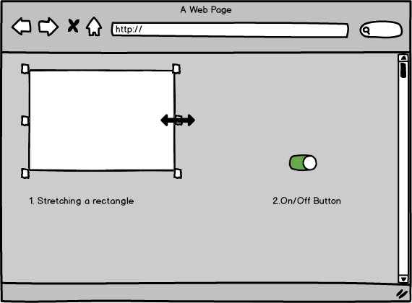

The user feels a sense of control when able to manipulate the objects that are necessary to perform a task in a manner similar to what would occur if the object were a physical thing.

Slide 50
Golden Rules (2)
Reduce the user’s memory load: When users are involved in some complex tasks the demand on short-term memory is significant. So the interface should be designed in such a way to reduce the remembering of previously done actions, given inputs and results.
Establish meaningful defaults
Define shortcuts that are intuitive
The visual layout of the interface should be based on a real-world metaphor
Disclose information in a progressive fashion
Notes:
Reduce demand on short-term memory: When users are involved in some complex tasks the demand on short-term memory is significant. So the interface should be designed in such a way to reduce the remembering of previously done actions, given inputs and results.
Establish meaningful defaults: Always initial set of defaults should be provided to the average user, if a user needs to add some new features then he should be able to add the required features.
Define shortcuts that are intuitive: Mnemonics should be used by the user. Mnemonics means the keyboard shortcuts to do some action on the screen.
The visual layout of the interface should be based on a real-world metaphor: Anything you represent on a screen if it is a metaphor for real-world entity then users would easily understand.
Disclose information in a progressive fashion: The interface should be organized hierarchically i.e. on the main screen the information about the task, an object or some behavior should be presented first at a high level of abstraction. More detail should be presented after the user indicates interest with a mouse pick.

Slide 51
2.Reduce the User’s Memory Load
A software must not force a user to memorize anything. On the other hand, it should provide recall feature to provide data when it is needed by storing it in its memory.

Slide 52
2.Reduce the User’s Memory Load
1.
Reduce demand on short-term memory.

Slide 53
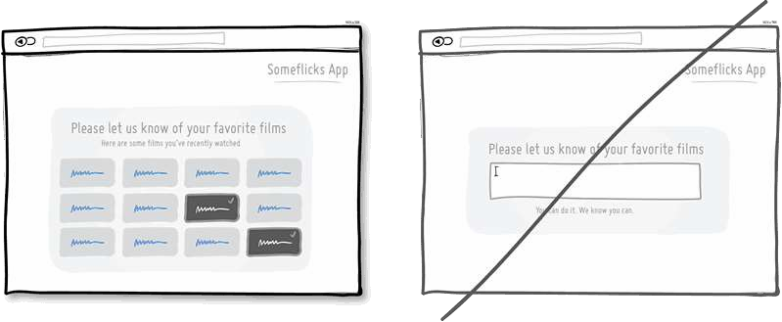

User Interface must be designed such that visual cues are provided to the user which helps him/her in reusing previous results etc.

Slide 54
2.Reduce the User’s Memory Load
2.
Establish meaningful defaults.

Slide 55
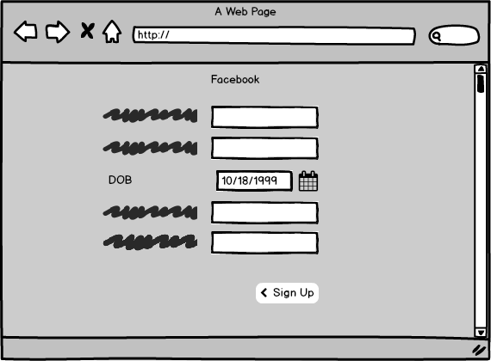
The default values of such properties must be meaningful
i.e. generally used.
The user must be able to change the properties if he/she wants to. Also, user must be able to reset the properties to their default values.

Slide 56
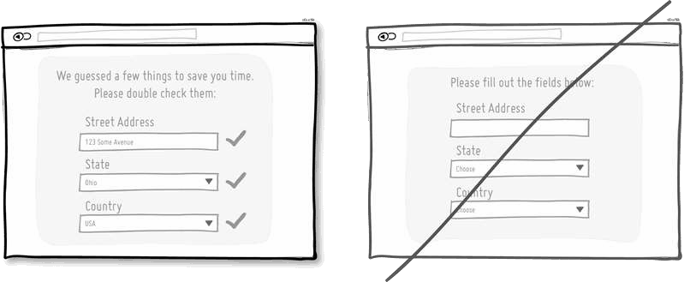
The default values of such properties must be meaningful
i.e. generally used.
The user must be able to change the properties if he/she wants to. Also, user must be able to reset the properties to their default values.

Slide 57
2.Reduce the User’s Memory Load
3.
Define shortcuts that are intuitive.

Slide 58

The shortcuts must be designed such that they are easy to remember i.e. Ctrl + C to copy is easy to remember as C is for Copy etc.

Slide 59



Photos
Add User
Cloud
Battery
Let’s match the column.

Slide 60
2.Reduce the User’s Memory Load
4.
The visual layout of the interface should be based on a real-world metaphor.

Slide 61

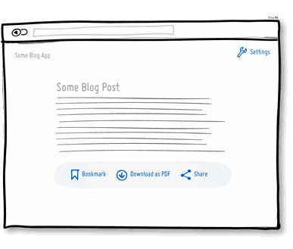
Real-world metaphor enables the user to rely on well- understood visual cues, rather than memorizing an arcane interaction sequence.

Slide 62
2.Reduce the User’s Memory Load
5.
Disclose information in a progressive fashion.

Slide 63
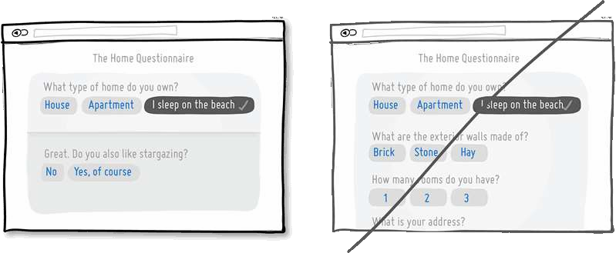

According to this principle, user interface must be such that general underline must be shown at low levels of abstractions and users can go to higher levels of abstraction by a mouse click etc,.

Slide 64
Golden Rules (3)
Make the interface consistent: Allow the user to put the current task into a meaningful context:
Many interfaces have dozens of screens. So it is important to provide indicators consistently so that the user know about the doing work. The user should also know from which page has navigated to the current page and from the current page where can navigate.
Maintain consistency across a family of applications: The development of some set of applications all should follow and implement the same design, rules so that consistency is maintained among applications.
If past interactive models have created user expectations do not make changes unless there is a compelling reason.
Notes:
Allow the user to put the current task into a meaningful context: Many interfaces have dozens of screens. So it is important to provide indicators consistently so that the user know about the doing work. The user should also know from which page has navigated to the current page and from the current page where can navigate.
Maintain consistency across a family of applications: The development of some set of applications all should follow and implement the same design, rules so that consistency is maintained among applications.
If past interactive models have created user expectations do not make changes unless there is a compelling reason.

Slide 65
3.Make the Interface Consistent
This includes organization of visual information according to design rules common to all types of screens, defining and implementing mechanisms for navigation from task to task consistently etc,.

Slide 66
3.Make the Interface Consistent
1.
Allow the user to put the current task into a meaningful context.

Slide 67
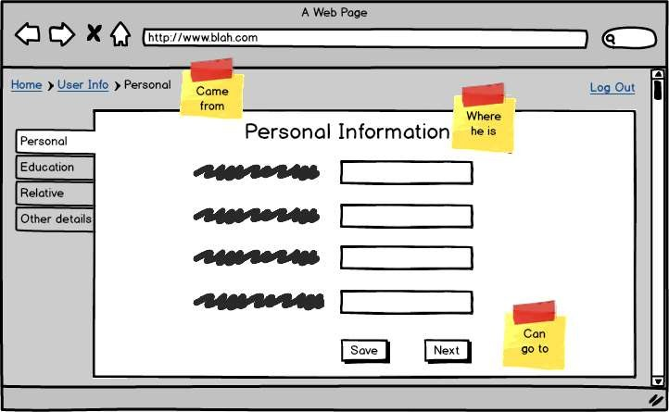

The interface must be in a way that enables the users to know the context of the current task. So, there should be some indicators which say from which task did the user come here and to which task he/she can go from here

Slide 68
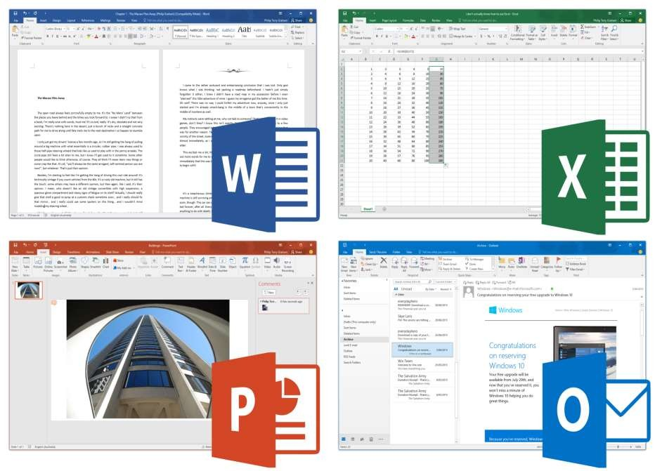

Slide 69
3.Make the Interface Consistent
2.
Maintain consistency across a complete product line.

Slide 70

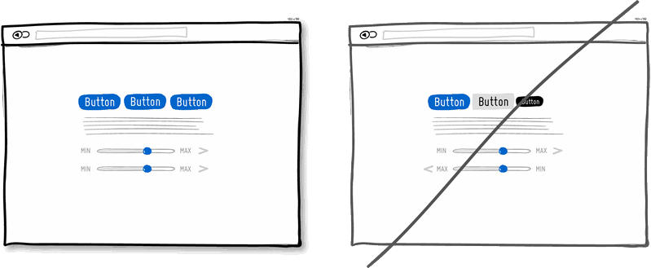
This rule suggests that a set of software applications should implement same design rules if possible so that interaction gets easier with time
Product 1 :
Product 2 :

Slide 71
3.Make the Interface Consistent
3.
If past interactive models have created user expectations, do not make changes unless there is a compelling reason to do so.

Slide 72
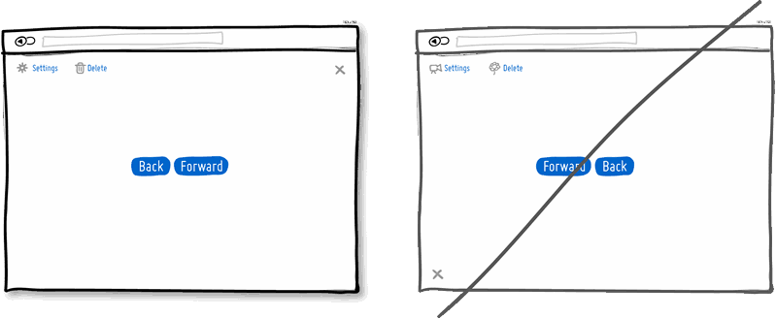

Suppose a special feature or an UI is provided in a previous version of the software application and its popular among its users, do not try to remove it or change it.

Slide 73
Golden Rules (4,5)
Strive for consistency - Consistent sequences of actions should be required in similar situations. Identical terminology should be used in prompts, menus, and help screens. Consistent commands should be employed throughout.
Enable frequent users to use short-cuts - The user’s desire to reduce the number of interactions increases with the frequency of use. Abbreviations, function keys, hidden commands, and macro facilities are very helpful to an expert user.

Slide 74
Golden Rules (6,7)
Offer informative feedback - For every operator action, there should be some system feedback. For frequent and minor actions, the response must be modest, while for infrequent and major actions, the response must be more substantial.
Design dialog to yield closure - Sequences of actions should be organized into groups with a beginning, middle, and end. The informative feedback at the completion of a group of actions gives the operators the satisfaction of accomplishment, a sense of relief, the signal to drop contingency plans and options from their minds, and this indicates that the way ahead is clear to prepare for the next group of actions.

Slide 75
Golden Rules (8,9)
Offer simple error handling - As much as possible, design the system so the user will not make a serious error. If an error is made, the system should be able to detect it and offer simple, comprehensible mechanisms for handling the error.
Permit easy reversal of actions - This feature relieves anxiety, since the user knows that errors can be undone. Easy reversal of actions encourages exploration of unfamiliar options. The units of reversibility may be a single action, a data entry, or a complete group of actions.

Slide 76
Golden Rules (10)
Support internal locus of control - Experienced operators strongly desire the sense that they are in charge of the system and that the system responds to their actions. Design the system to make users the initiators of actions rather than the responders.

Slide 77


